Slide 1
Module -3 Chapter-1
Database Design Theory

Slide 2
Normalization
Normalization is the process of organizing data into tables to reduce redundancy and improve data integrity. It also helps to avoid anomalies like update, deletion, and insertion issues.
What it does
Organizes data into tables and defines relationships between them
Why it's important
Reduces redundancy, prevents inconsistent dependencies, and improves data integrity
How it works
Breaks large tables into smaller tables and links them through relationships
Benefits
Makes databases more flexible, easier to understand, and easier to enhance and extend

Slide 3
Informal Design Guidelines for Relation Schemas
Four informal guidelines that may be used as measures to determine the quality of relation schema design:
1. Making sure that the semantics of the attributes is clear in the schema
2. Reducing the redundant information in tuples
3. Reducing the NULL values in tuples
4. Disallowing the possibility of generating spurious tuples
These measures are not always independent of one another

Slide 4
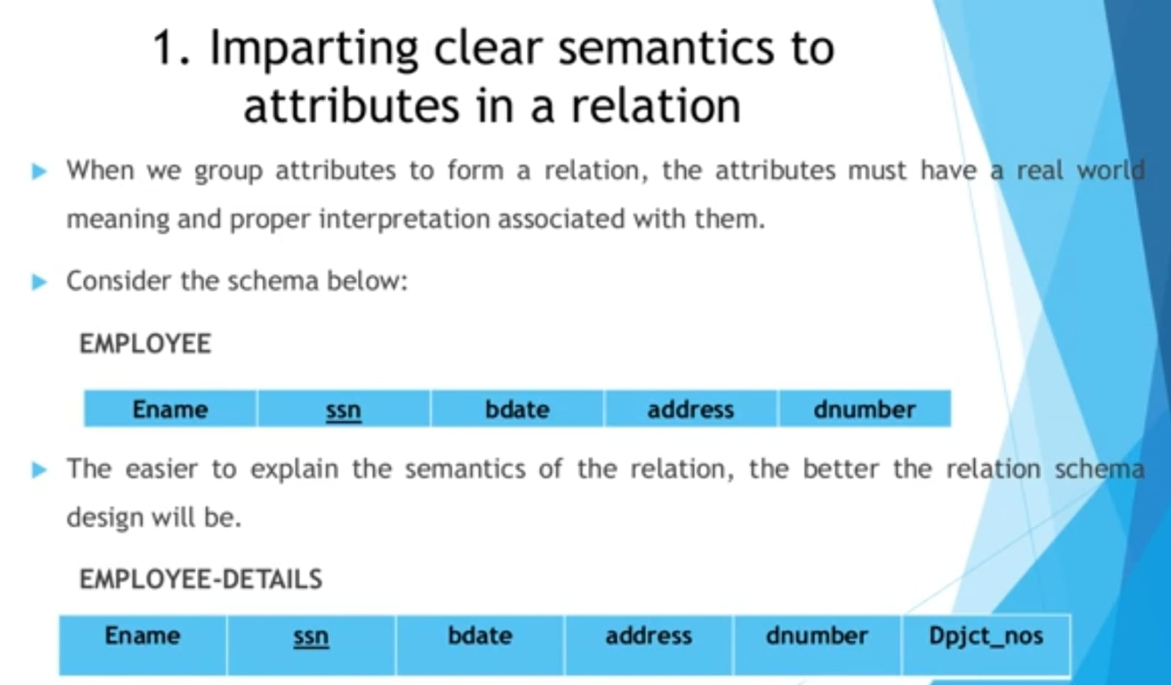

Slide 5
Here in Relation employee is having clear Semantics.
In relation Employee-Details we are having department project number which represents Number of project which is handled by that particular department which is not a property od employee it’s a property of department.
When we collect attribute to form a relation it should contain only the property of that real. world object

Slide 6
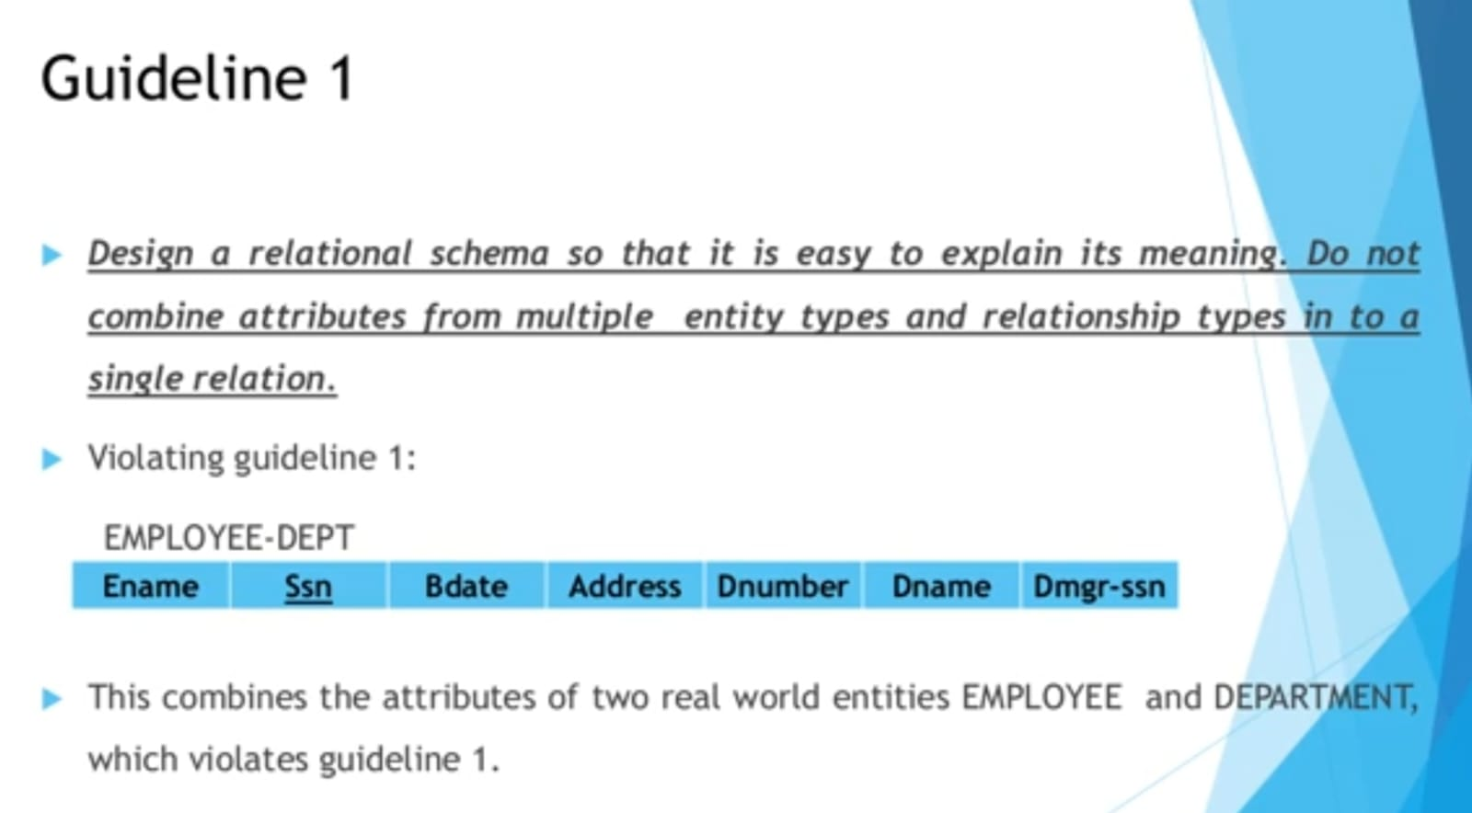

Slide 7
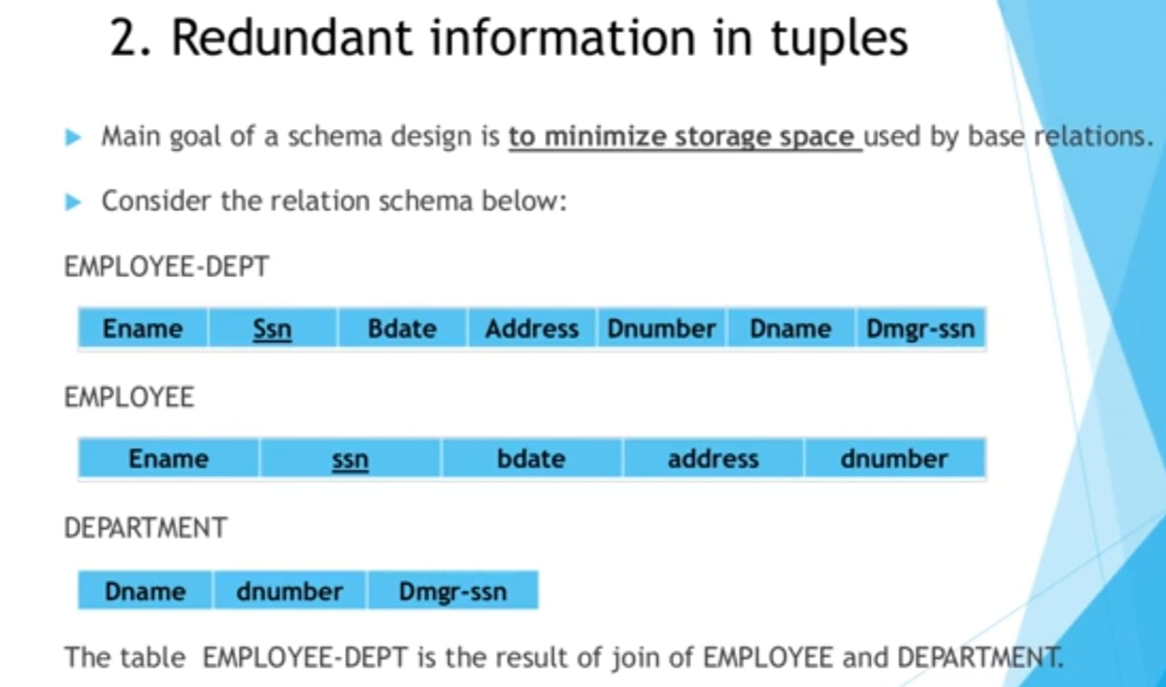
Employee- DEPT result in redundant information

Slide 8
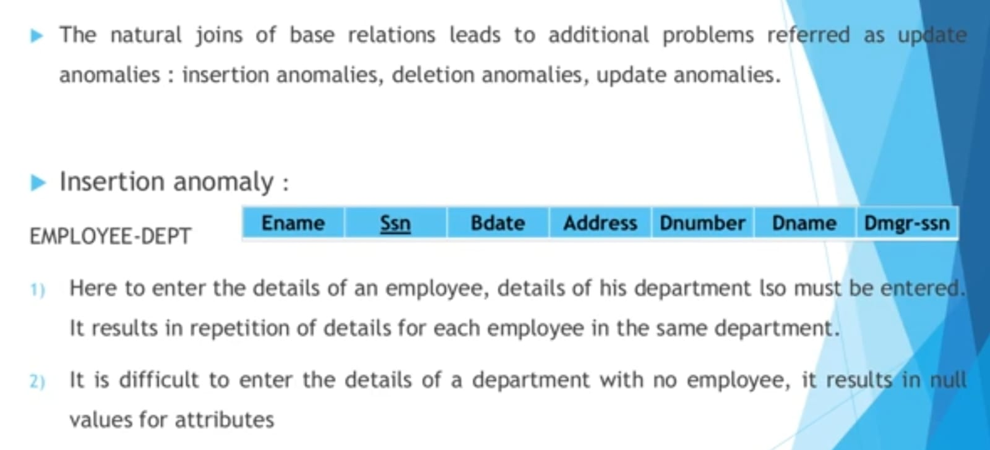

Slide 9
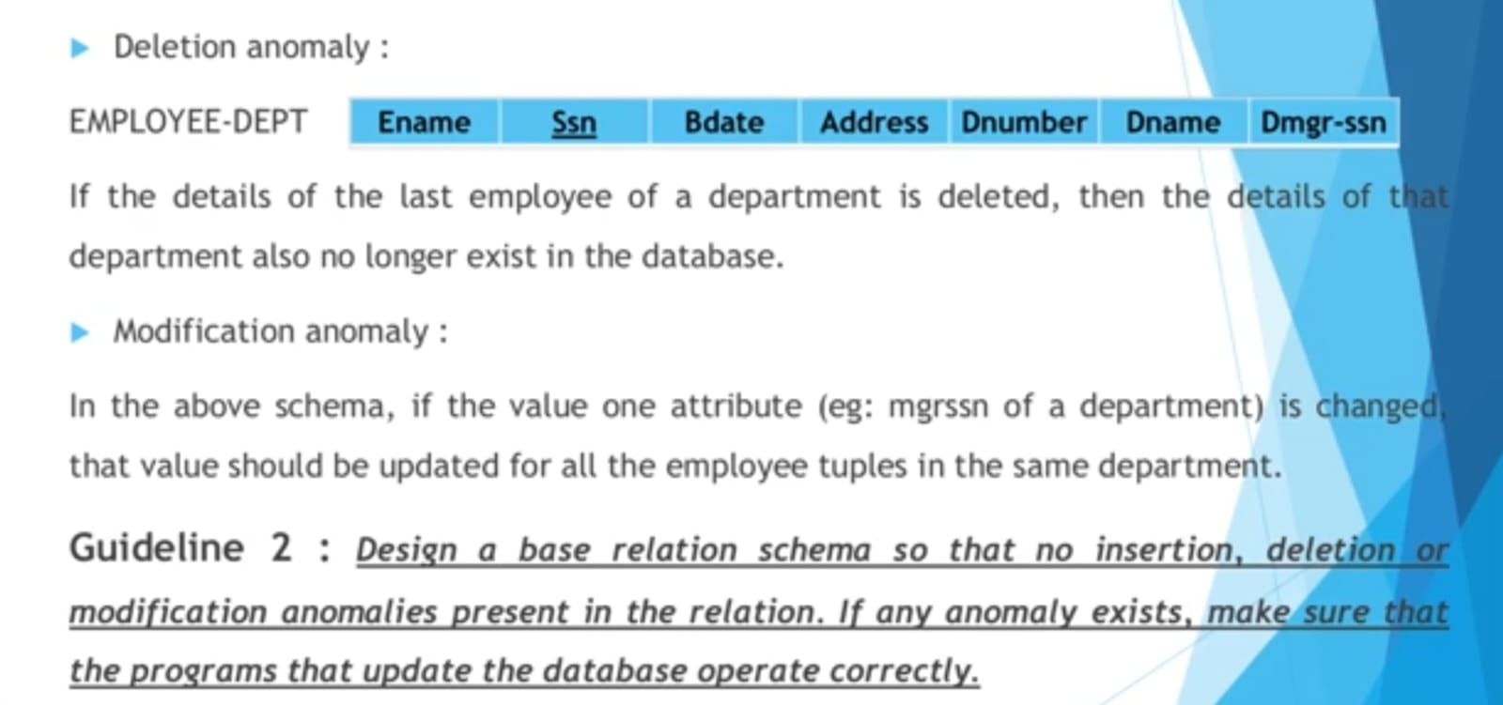

Slide 10
ANOMALIES
It is a fault occurs in a database due to the poor design of the database or storing the data in flat database.
Three types of anomalies
Insertion anomaly
Occurs during inserting data
Unable to insert without presence of other attribute.
Deletion anomaly
Occurs during deletion of data
If some data is deleted with the deletion of other data.

Slide 11
Updation anomaly
Occurs during updating the data.
If table consist of redundancy updation anomaly occur.
One way to avoid this anomaly is to use NORMALIZTION OR DECOMPOSITION(lossless decomposition)
Normalization or Decomposition means dividing the table into different tables (sub tables) , splitting and joining both are called as normalization or decomposition.

Slide 12
Student-Course
Stu_id | Stu_name | Address | Course_Title | Duration
100 | Rakshitha | Bangalore | Python | 2
100 | Rakshitha | Bangalore | Java | 4
101 | Manjula | Mysore | C | 3
102 | Ashok | Krishnagiri | Python | 2
103 | Mahesh | Doddaballapura | Java | 4
103 | Monish | Jakkur | Python | 3

Slide 13
Primary Key=Stu_id+course_Title
Insertion Anomaly
Data cant be inserted into Student without course.
Deletion Anomaly
Deletion of course will delete student also.
Updation anomaly
Change of address for stu_id 101 will not reflect on other tuples.

Slide 14
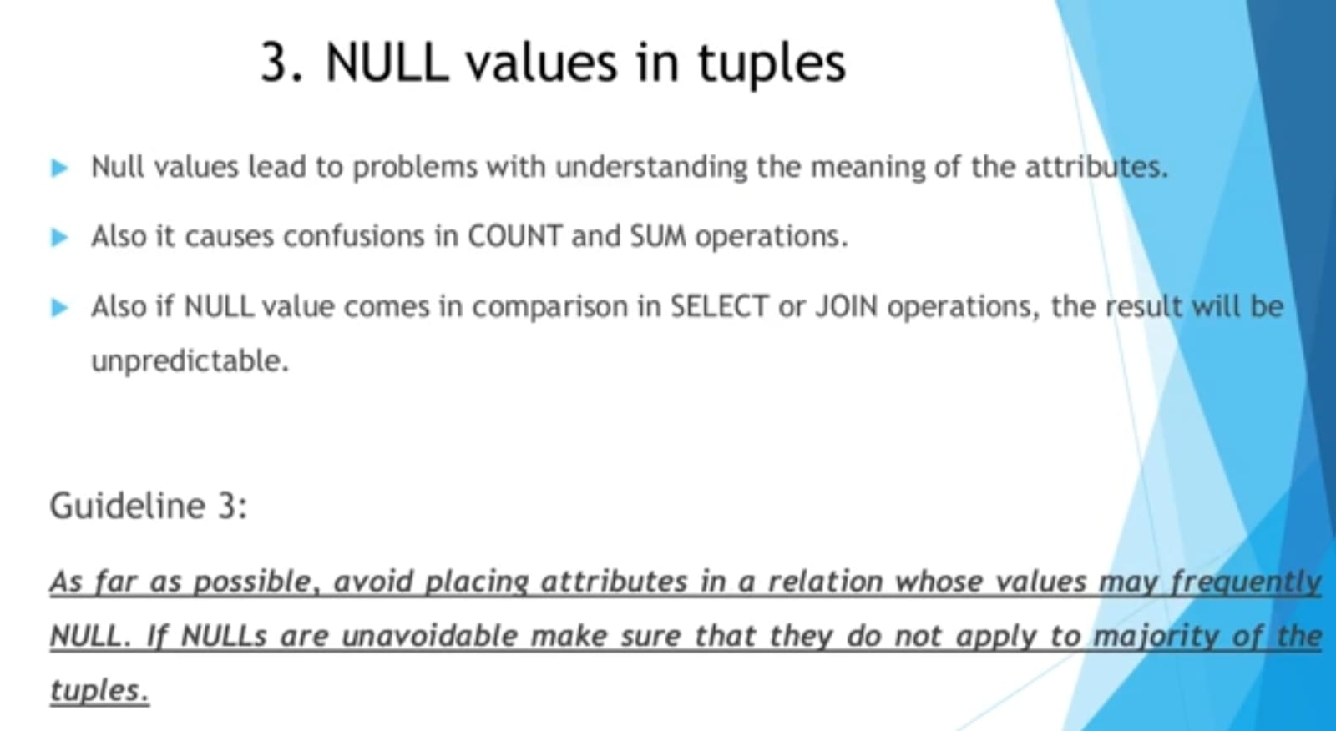

Slide 15
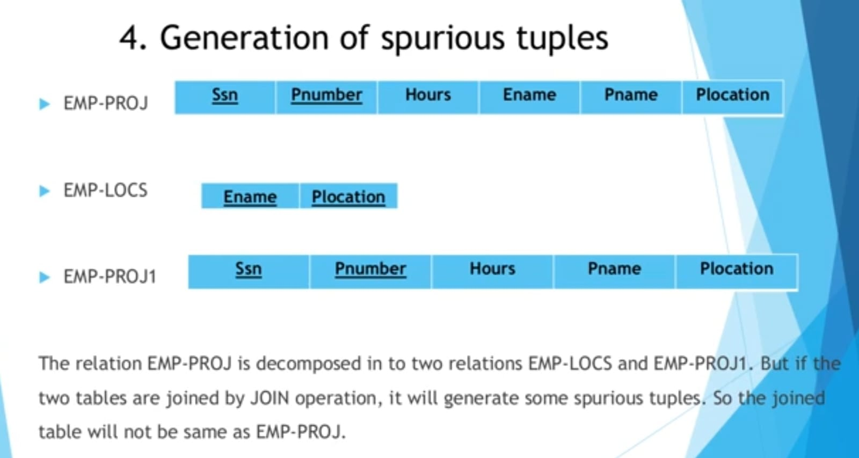
Spurious Tuples an unwanted or incorrect row (or tuple) that appears when joining two or more tables improperly, especially when joining on attributes that are neither primary nor foreign keys.

Slide 16
1) Spurious Tuples are generated in join operation or cross product. 2) Here Ename + Plocation together form a primary key. 3) While joining 2 table primary key of one tuple and foreign key of another tuple(same attribute) should match or else spurious tuple(meaning less tuple) will occur. 4) When joining these two table we are going to compare Plocation but in relation EMP-LOCS Plocation is not primary key(independently not unique). 5) Here we are not using primary key combination in this case spurious tuples will occur

Slide 17
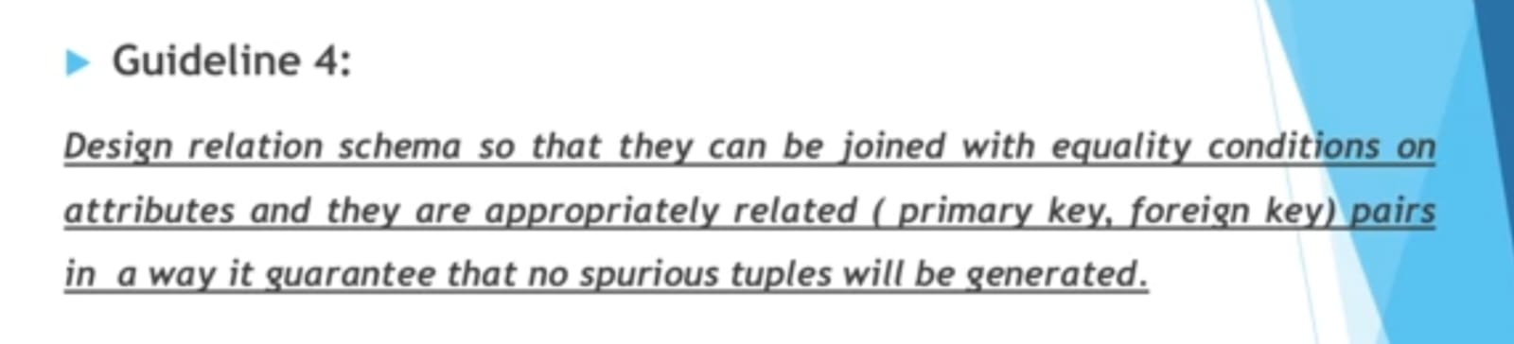

Slide 18
Functional Dependency
A functional dependency is a constraint between two sets of attributes from the database.
Given a relation R, a set of attributes X in R is said to functionally determine another attribute Y, also in R, (written X Y) if and only if each X value is associated with at most one Y value.
X is the determinant set and Y is the dependent attribute. Thus, given a tuple and the values of the attributes in X, one can determine the corresponding value of the Y attribute.

Slide 19
The abbreviation for functional dependency is FD or f.d. The set of attributes X is called the left-hand side of the FD, and Y is called the right-hand side.
A functional dependency is a property of the semantics or meaning of the attributes.
The database designers will use their understanding of the semantics of the attributes of R to specify the functional dependencies that should hold on all relation states (extensions) r of R.

Slide 20
Normalization
Normalization of data can be considered a process of analyzing the given relation schemas based on their FDs and primary keys to achieve the desirable properties of
(1) minimizing redundancy and
(2) minimizing the insertion, deletion, and update anomalies

Slide 21
Practical Use of Normal Forms
Normalization is carried out in practice so that the resulting designs are of high quality and meet the desirable properties
Database design as practiced in industry today pays particular attention to normalization only up to 3NF, BCNF, or at most 4NF.
The database designers need not normalize to the highest possible normal form
Relations may be left in a lower normalization status, such as 2NF, for performance reasons
Definition: Denormalization is the process of storing the join of higher normal form relations as a base relation, which is in a lower normal form.

Slide 22
Definitions of Keys and Attributes Participating in Keys
Superkey: specifies a uniqueness constraint that no two distinct tuples in any state r of R can have the same value
key K is a superkey with the additional property that removal of any attribute from K will cause K not to be a superkey any more
If a relation schema has more than one key, each is called a candidate key
One of the candidate keys is arbitrarily designated to be the primary key, and the others are called secondary keys

Slide 23
In a practical relational database, each relation schema must have a primary key
If no candidate key is known for a relation, the entire relation can be treated as a default superkey.
example :{Ssn} is the only candidate key for EMPLOYEE, so it is also the primarykey
An attribute of relation schema R is called a prime attribute of R if it is a member of some candidate key of R. An attribute is called nonprime if it is not a prime attribute that is, if it is not a member of any candidate key.

